Slide 2
A Loving People
A Righteous People
A Unified People
An Obedient People
A Growing People

Slide 3
A Growing People
Philippians 3:12 Not that I have already obtained this or am already perfect, but I press on to make it my own, because Christ Jesus has made me his own.

Slide 4
A Growing People
Luke 12:27 Consider the lilies, how they grow: they neither toil nor spin; but I tell you, not even Solomon in all his glory clothed himself like one of these.

Slide 5
A Growing People
1 Peter 2:2 like newborn babies, long for the pure milk of the word, so that by it you may grow in respect to salvation

Slide 6
A Growing People
2 Peter 3:18 but grow in the grace and knowledge of our Lord and Savior Jesus Christ. To Him be the glory, both now and to the day of eternity. Amen.

Slide 7
A Growing People
Ephesians 4:15-16 but speaking the truth in love, we are to grow up in all aspects into Him who is the head, even Christ 16 from whom the whole body, being fitted and held together by what every joint supplies, according to the proper working of each individual part, causes the growth of the body for the building up of itself in love.

Slide 8
A Growing People

Slide 9
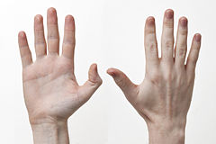
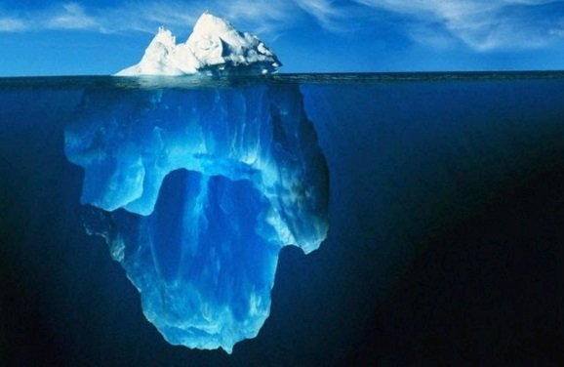
Attention
Action
Attitude

Slide 10
Attention
A Growing People
Colossians 3:2 Set your mind on the things above, not on the things that are on earth.

Slide 11
Attention
A Growing People
Mark 4:30-12 And He said, How shall we picture the kingdom of God, or by what parable shall we present it? 31 It is like a mustard seed, which, when sown upon the soil, though it is smaller than all the seeds that are upon the soil, 32 yet when it is sown, it grows up and becomes larger than all the garden plants and forms large branches; so that the birds of the air can nest under its shade.

Slide 12
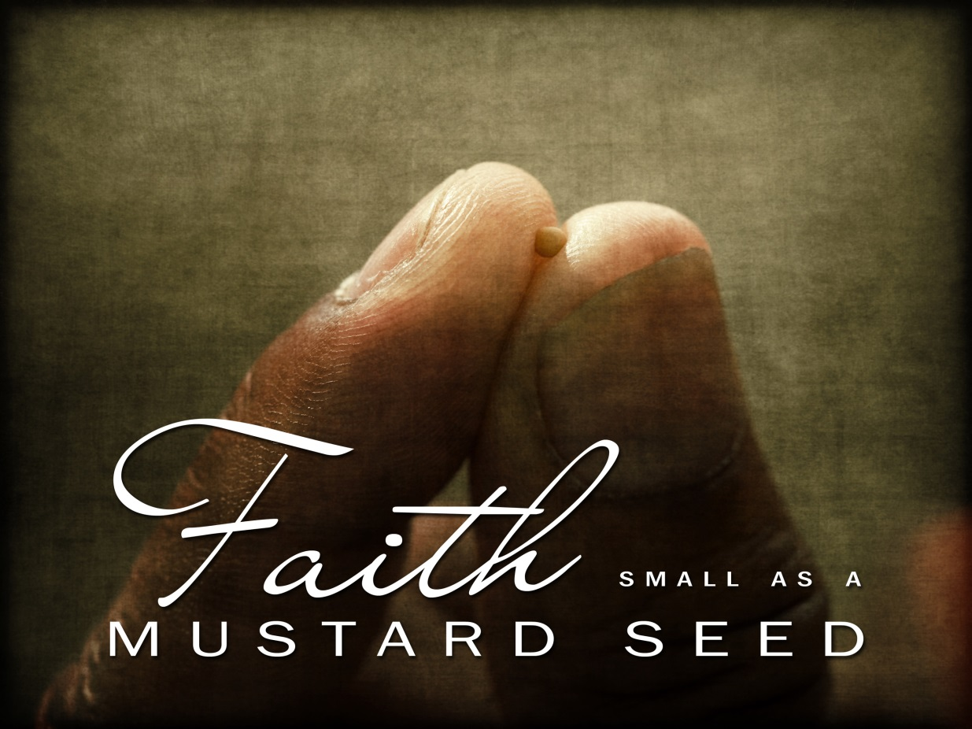
Attention
A Growing People

Slide 13
Action
A Growing People
Acts 17:21 (Now all the Athenians and the strangers visiting there used to spend their time in nothing other than telling or hearing something new.)

Slide 14
Action
A Growing People
1. Create a framework for success

Slide 15
Action
A Growing People
2. Share your goals with others

Slide 16
Action
A Growing People
3. Set small milestones and celebrate success

Slide 17
Attitude
A Growing People
Acts 26:24 While Paul was saying this in his defense, Festus said in a loud voice, Paul, you are out of your mind! Your great learning is driving you mad.

Slide 18
Attitude
A Growing People
Acts 12:24 But the word of the Lord continued to grow and to be multiplied.

